Slide 1
Azure IOT Hub Overview
Michael Chi
DX TED
Technical Evangelist

Slide 2
IoT is an Inflection Point
Hardware
is cheap
Connectivity
is pervasive
Development
is easy
Cloud can deal with big data
New Innovative Scenarios
Notes:
IoT is not that new, we’ve been connecting devices to networks and the internet for (probably) 25 or 30 years.
Hardware is Cheap
The cost of hardware has plummeted. This is part Moore’s law, part the explosive growth of high tech manufacturing, particularly in Asia. It is now cost effective to deploy hardware where we may not have before. Hardware is now more sacrificial than it has been in the past.
> Infrared/ambient temp sensor, ambient light, humidity, barometric pressure, 9-axis motion (accelerometer, gyroscope, compass), magnet
Connectivity is Pervasive
Somewhat related is the pervasive nature of cost effective connectivity. Particularly wireless connectivity. This is, in many ways, driven by the same forces driving the downward march of hardware costs.
Development is Easier
Reticent to say that Development is Easy. But, it is certainly easier. This is thanks to now being able to use rich programming tools, languages and environments across the full stack. Programming on embedded devices was traditionally done with assembler or C. It would have been unimaginable that we’d be using things like JavaScript as a first class programming language on hardware devices.
Cloud Can Deal with Big Data
In the past, many applications of telemetry and field sensors were limited by the computing power at the backend being able to store and process huge volumes of data. The cloud flips that problem. With the cloud we have effectively unlimited capacity on tap. We’re now in the situation where application scenarios are voracious for more data and the IoT helps us to get that data.
New Innovative Scenarios
And this whole set of factors is unlocking innovative new scenarios; at every level of every industry. Smart power grids, smart homes, smart factories and smart cars. One of the case studies we’ll look at later is even using IoT in agriculture to instrument smart cows.

Slide 3
IoT 2010
Alarm clock
Refrigerator
Automobile
VoIP phone
Computer
Printer
Media player
Microwave
HOME
WORKPLACE
HOME
Coffee maker
Smart scale
Oven
Cell phone
HVAC
Vending
Security
Television
Notes:
This has happened quickly
We had early generations of smart cars, smart refrigerators and smart WiFi scales
However, devices were isolated, stand alone and typically had their own exclusive ecosystem
Devices were typically expensive, or only certain models

Slide 4
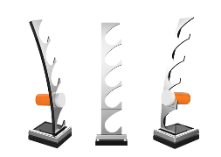
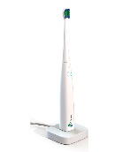
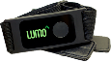
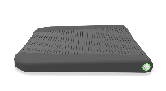
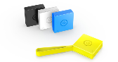
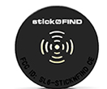


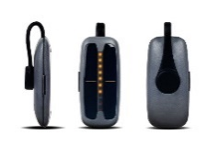
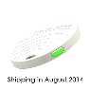
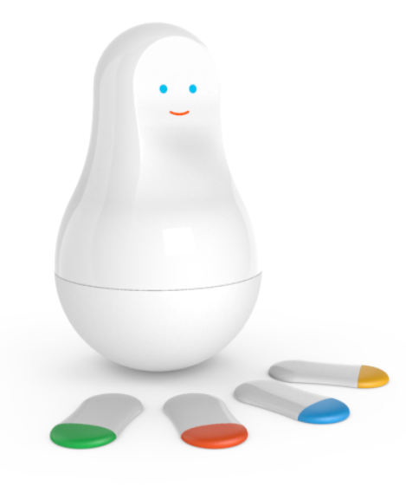
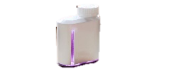

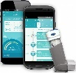
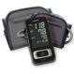
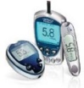
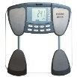
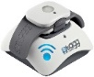
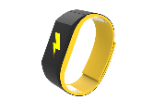
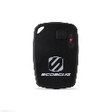

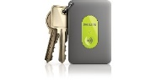
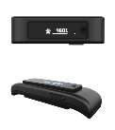



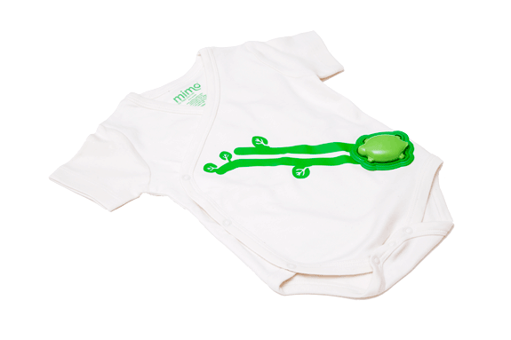
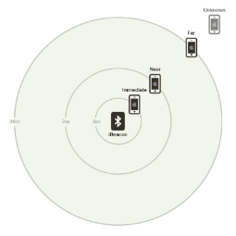
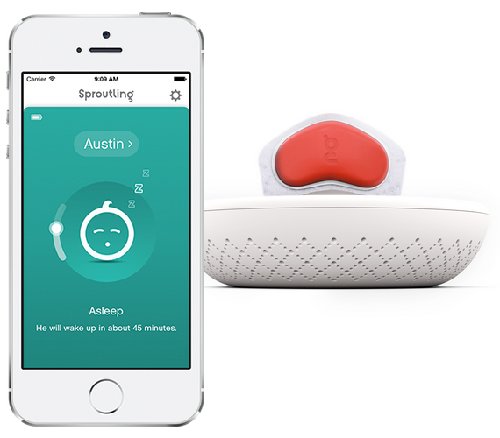

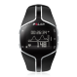
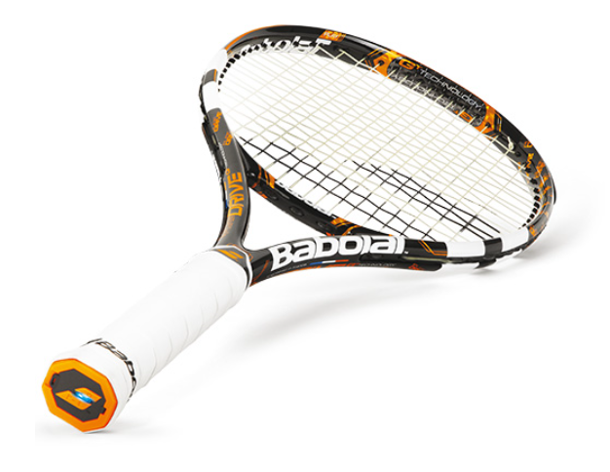
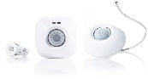
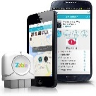
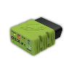
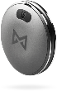
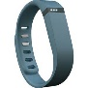
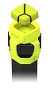
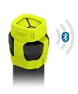
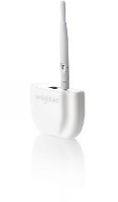
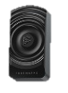

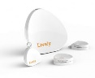
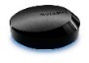
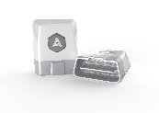
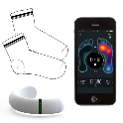
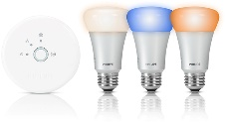
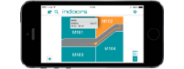
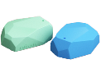
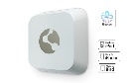
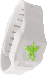
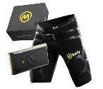
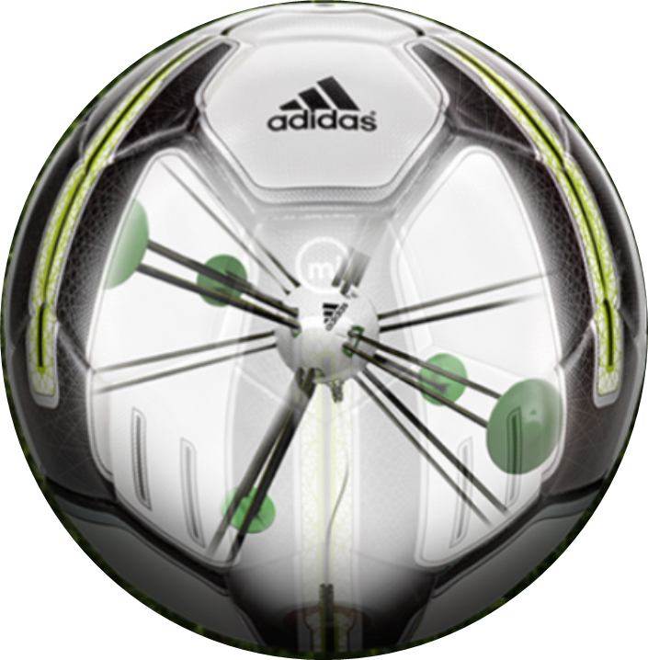


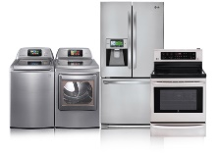
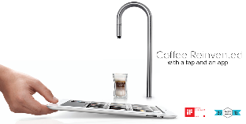
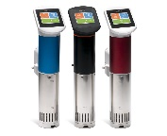
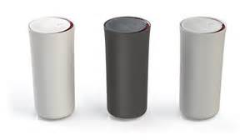
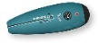
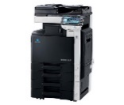










































IoT 2016
Medication adherence
Health monitoring
Pet tracking
Behavior modification
Object tracking
Child and elder monitoring
Sports and fitness
Indoor navigation
Trip tracking and car health
Smart lighting
Beacons and proximity
COMMUTE
COMMUTE
HOME
WORKPLACE
HOME
Smart appliances
Food and nutrition tracking
Identity
Office equipment
Smart vending machines
Bike ride stats and protection
Air conditioning and temperature control
Sleep tracking
Environmental sensors
Information capture
Control
Home security
Home automation
Leak detection
Garden, lawn and plant care
New devices and sensors
Entertainment systems
Notes:
- Ecosystems are integrated. Customers expect their phone to work with their watch and their car and their coffee machine.
Boundary is blurring between ‘work’ & ‘play’… many devices have a dual purpose
There are many more devices at the smaller & cheaper end of the spectrum. Not unusual to have network connectivity in a device costing a few bucks.
The explosion of new smart hardware devices needs to be supported by a broad, hyperscale service back-end to allow the integration between hardware ecosystems.

Slide 5

25 BILLION Connected “things” will be in use by 2020
$7.2 TRILLION worldwide market for IoT solutions by 2020
IDC: Worldwide and Regional Internet of Things (IoT) 2014–2020 Forecast
Gartner
Notes:
Various estimates of market size and all of the large analyst firms are taking an active interest.
Discuss Gartner number
Over 3 connected things for every man, woman and child on earth
Discuss IDC number

Slide 6
IoT Business Maturity Model 1. Operational efficiency
Connect devices and monitor telemetry
Monitor and track device state, location and health
Things
Rules and alerting to improve operational efficiency
Notes:
Most customers adopting the IoT tend to follow a similar pattern.
- It starts with organizations hunting for operational efficiency.
- Subsequently they begin by connecting devices and capturing data. The cloud means that traditional concerns about ‘too much data’ are much less prevalent.
- Customers will be monitoring the IoT devices themselves and the things they they’re connected to.
Often customers will be using real time rules and alerting to make decisions in an ad hoc fashion about their things.

Slide 7
IoT Business Maturity Model 2. Business Intelligence
Analyze and visualize data from devices
Discover patterns in device data using predictive analytics
Things
Operationalize insights to improve things and processes in real time
Notes:
Next, organizations start to develop some business intelligence around the huge streams of data.
Once they’ve built a data set customers will start to derive insight from this. This moves from experimentation and exploration of data to insight, often using machine learning and other statistical and predictive models.
The cloud and predictive analytics work really well together. This is because predictive analytics requires a lot of computing power, which is ‘on tap’ in the cloud.
Insight allows customers to take better decisions as they run their business. Some of these will be real time operationalization of predictive models, some of these will be longer term strategic decisions.

Slide 8
IoT Business Maturity Model 3. Business Transformation
Combine IoT & other data with advanced analytics to power new services and revenue streams
Expand into new adjacent businesses
Things
New partnership opportunities
Notes:
Customers then integrate IoT into their broader business and explore new areas in which to deploy IoT solutions.
Data and devices in the field unlock new opportunities to partner with other organisations who’re also interested in the hardware platforms and data streams.
The cycle continues.

Slide 9


典型架构
数据源
归纳
采集 (broker)
转换
持久化
展现及反馈
Stream Analytics
Web Site
Applications
Event Hub
Event Hub
Legacy IOT (custom protocols)
Azure DBs
Bing Search
Cloud gateways (web APIs)
Stream processing
Devices
Storage adapters
Azure Blob
Data analytics (Excel)
IP-capable devices (Windows/Linux)
Low-power devices (RTOS)
Field gateways
Devices to take action

Slide 10
Microsoft Azure IoT Platform
On-Prem / Field
On-Prem / Azure
Azure
Protocol Bridge
D2C Ingestion
C2D Messaging
Device Registry
Device Identity
Device Provisioning
Real-time Processing
cv
cv
cv
Client Connectivity
Storage
Event Ingestion
Data Analytics
Predictive Analytics
Dashboards
Process Automation
Stream Analytics
AMQP, HTTPS, MQTT
AMQP
Devices
BLOB
Azure ML
IoT Hub
HDInsight STORM
SQL DB
Notification Hub
QUEUE
Event Hub
Power BI
Web Apps
Field Gateway
HDInsight
Event Processor Host
AMQP, HTTPS, MQTT
AMQP
{ SDK – .NET C#,
JS, C, JAVA, Python }
{ OS - Win, Linux,
RTOS, MBED }
Key IoT Capabilities and Technologies

Slide 11
Microsoft Azure IoT Platform
On-Prem / Field
On-Prem / Azure
Azure
Protocol Bridge
D2C Ingestion
C2D Messaging
Device Registry
Device Identity
Device Provisioning
Real-time Processing
cv
cv
cv
Client Connectivity
Storage
Event Ingestion
Data Analytics
Predictive Analytics
Dashboards
Process Automation
Stream Analytics
AMQP, HTTPS, MQTT
AMQP
BLOB
Devices
SQL DB
Notification Hub
QUEUE
Azure ML
IoT Hub
HDInsight STORM
Web Apps
Event Hub
HDInsight
Mobile Apps
Field Gateway
Power BI
Data Lake
Logic Apps
Event Processor Host
Data Factory
AMQP, HTTPS, MQTT
AMQP
{ SDK – .NET C#,
JS, C, JAVA, Python }
{ OS - Win, Linux,
RTOS, MBED }
Document DB
Key IoT Capabilities and Technologies

Slide 12















Azure IoT 服务
设备 | 连接 | 存储 | 分析 | 展现
 | Event Hubs | SQL Database | Machine Learning | App Service
 | Service Bus | Table/Blob Storage | Stream Analytics | Power BI
 | External Data Sources | DocumentDB | HDInsight | Notification Hubs
 |  | External Data Sources | Data Factory | Mobile Services
 |  |  |  | BizTalk Services
{ }

Slide 13


IoT Hub : the Azure IoT Cloud Gateway
Your IoT Hub
Event processing
(hot and cold path)
Device
Device ID
D2C receive endpoint
D2C send endpoint
Device business logic,
connectivity monitoring
C2D queue
endpoint
C2D send endpoint
Field GW/
Cloud GW
Msg feedback and monitoring endpoint
Device …
Device …
Device provisioning and management
Device identity management
Device …
IoT Hub management

Slide 14



Azure IoT Hub
Connect Devices bi-directionally to Azure IoT Services
Receive / Send messages from / to millions of devices concurrently
Control & Monitor Devices
Add / Remove and Enable / Disable devices
Store device information (meta-data)
Per-device Authentication and Authorization

Slide 15
IoT Hub : features
Connection
bidirectional comunication
reliable & secure channel
per-device authentication
multiplexing
Features
device to cloud telemetry
cloud to device commands and notifications (with TTL & feedback)
bulk uploads/downloads
monitoring devices (connection, activity, ...)
multi protocols (AMQP, HTTP) → IoT Protocol Gateway (MQTT)

Slide 16
IoT Hub : features
Features
Device management
Device twin
Device jobs
Device queries

Slide 17

Device Twin
Notes:
其中一個服務屬性範例是 <下一個服務日期, 11/12/2017>

Slide 18

Device Query
Notes:
若要使用服務屬性或裝置屬性來查詢裝置對應項，您可以使用 JSON 查詢運算式。下列範例示範如何使用具有索引鍵 FirmwareVersion 和值 1.0 的裝置屬性來查詢所有裝置。您可以看到屬性的「類型」為「裝置」，這表示我們是根據裝置屬性進行查詢，而非服務屬性︰

Slide 19

Device Job
Notes:
裝置作業
裝置管理的下一個概念是裝置作業，可協調多個裝置上的多步驟協調流程。
Azure IoT 中樞裝置管理目前提供六種類型的裝置作業 (我們會在客戶需要其他作業時新增作業)：
韌體更新：更新實體裝置上的韌體 (或 OS 映像)。
重新啟動：重新啟動實體裝置。
恢復出廠預設值：將實體裝置的韌體 (或 OS 映像) 還原為儲存在裝置上的原廠提供備份映像。
組態更新：設定實體裝置上執行的 IoT 中樞用戶端代理程式。
讀取裝置屬性︰取得實體裝置上裝置屬性的最新值。
寫入裝置屬性︰變更實體裝置上的裝置屬性。

Slide 20


Slide 21

IoT Hub for developers : SDKs
For devices and field gateway
Platforms
Windows
Linux
RTOS (freeRTOS), ARM mbed
Android, iOS
Languages
C#, C, Java, JavaScript (NodeJS)
For back-ends and cloud gateway
Languages
.Net C#
Java
JavaScript (NodeJS)
https://github.com/Azure/azure-iot-sdks
AMQP, MQTT and HTTP directly !!

Slide 22
Azure IoT SDKs
Device-facing
For devices and field gateway
Platforms
RTOS (TI-RTOS)
Linux (Ubuntu, Debian, Fedora, Raspbian)
Windows 7/8/10
ARM mbed
Languages
C (C99 compliant), Java, C#, Node
Service-facing
For back-ends and cloud gateway
Languages
.NET C#
Java
Node
https://github.com/Azure/azure-iot-sdks
AMQP, MQTT and HTTP directly !!

Slide 23

IoT Hub for developers : Hardware
Raspberry Pi 2
MinnowBoard Max
Dragonboard 410C
Freescale FRDM-K64F
TI CC3200
...
...
Your board !!

Slide 24
Identity, Authentication & Security
Identity
devices registry
provisioning APIs (create, delete, ...)
monitoring (connection status, activity, ...)
Authentication
permission (r-only registry, r/w registry, device, service)
policy made with one or more permissions
per-device auth with SAS token (from device id and device key)
Security
encrypted channel → SSL/TLS protocol

Slide 25

Prices, Quotas & Throttling
prices based on :
IoT Hub units (up to 200 or ... contact Microsoft Support)
number of devices
total number of messages/day
messages billed as 16 KB chunk
throttling based on identity registry ops, device connections, D2C & C2D operations
Notes:
Throughput (S2) = 23 GB/day/1 unit of IoT Hub
Scale Upto 200 Units of IoT Hub
=> 46000 GB/day i.e. 46 TB/day
2 - 32 Partitions - determine Read Parallelism
# of Partitions has no impact on PRICE!
So you can start with more! say 16 Partitions
Resource Group is a Logical Container for IaaS, PaaS, SaaS
1. Create IoT Hub
2. Create Device Identity (API) (unique Key per device)
3. Create Device Agent to send Device-to-Cloud Messages
4. Send Cloud-to-Device Messages
5. Send Messages from Stream Analytics to BLOB
6. Send Messages from Stream Analytics to Power BI (powerbi.com)
Device Agent can run on each device or just the field gateway
- Device (Agent) -> IoT Hub
- Device -> Gateway (Agent) -> IoT Hub
Transparent Gateway
=> 1 key used by Gateway + 1 key used for each device
=> Each device can be "White-Listed" by IoT Hub for Provision/De-Provision
=> 2 Way Authentication between Device and IoT Hub
=> Throttling is at Device Level (each device gets dedicated throughput channel with IoT Hub)
Opaque Gateway => 1 Key used by Gateway
=> 1 key used by Gateway (no key for device)
=> No "White-Listing"
=> 2 Way Authentication between Gateway and IoT Hub
=> Provision/De-provision handled by Gateway
=> Throttling is at Gateway Level (all devices share throughput channel with IoT Hub)
How you choose between 2 approaches?
- Depends of Volume of data you are sending to IoT Hub
- High Frequency, Lots of Concurrent Devices => Transparent Gateway
- Low Frequncy, Less Concurrency => Opaque Gateway
Note: Transparent Gateway also means you have GOOD Internet Connection
Power BI On-Prem Connectivity
- DIRECT Connection to SSAS (Tabular or Multi-dimensional)
- Data Management Gateway
e.g. RDBMS -> Excel / PBI Designer Report (PowerQuery Connection) -> PBI Gateway (on-prem) -> PBI.COM

Slide 26

https://azure.microsoft.com/zh-tw/documentation/articles/azure-subscription-service-limits/

Slide 27


Slide 28

https://azure.microsoft.com/en-us/documentation/articles/iot-hub-scaling/

Slide 29
DEMO
Portal experience
Tools – Device Explorer

